Slide 1




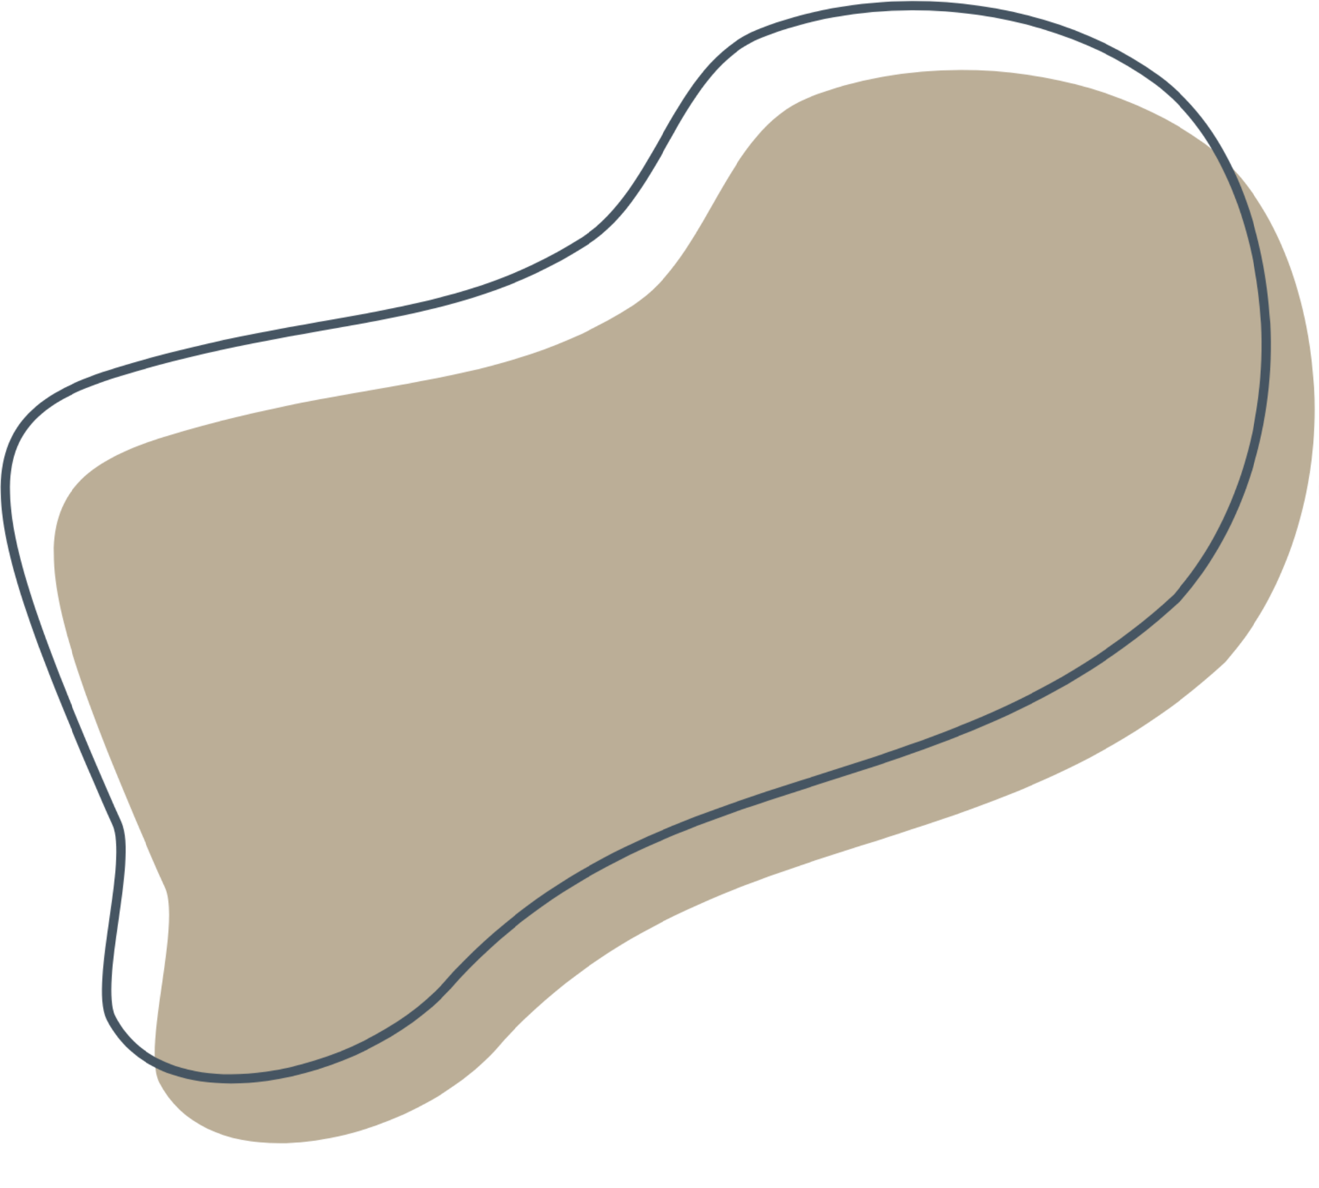

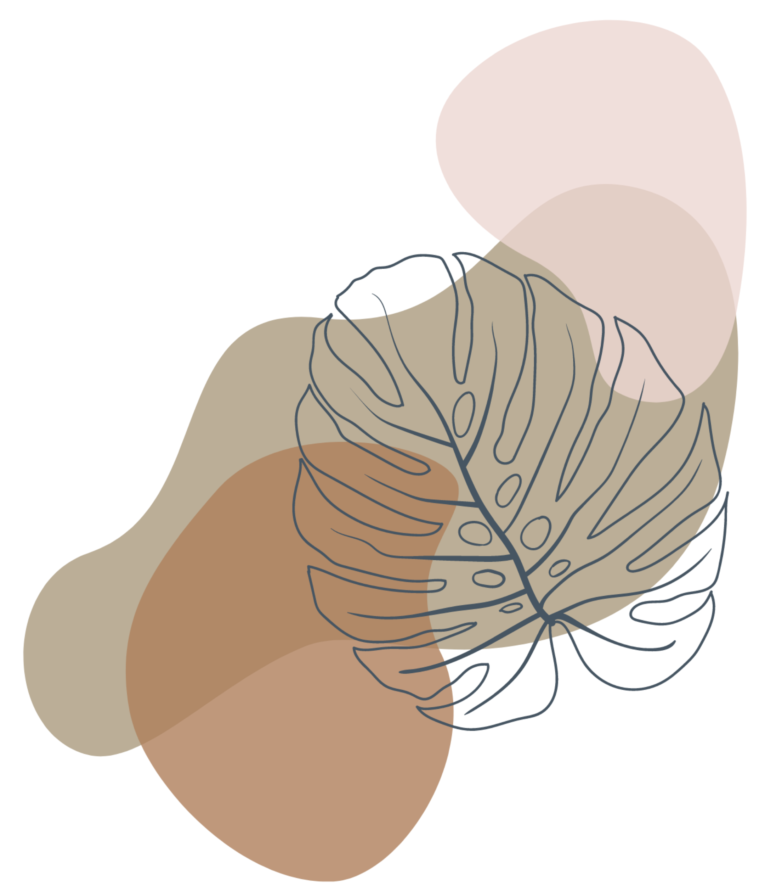
WATER QUALITY CHECKER
BATCH1
A PRESENTATION BY
G.ARYAN-22R21A6684
SAIVENKAT-22R21A6667
GUNASHEKAR-22R21A6676
NIREEKSHANA-22R21A6677

Slide 2
Table of
Content
Problem statement
Solution and design
Customer survey

Slide 3


PROBLEM STATEMENT :
Developing a reliable and affordable water quality checker to accurately measure the levels of contaminants in freshwater bodies and provide timely information to prevent health hazards and environmental damage."

Slide 4

solution
●One solution could be to develop a portable water quality checker
●A device that is easy to use and affordable for local communities and government agencies.
●The device could use advanced sensors and analytical techniques, such as spectrometry, to measure the levels of various contaminants in water bodies accurately

Slide 5
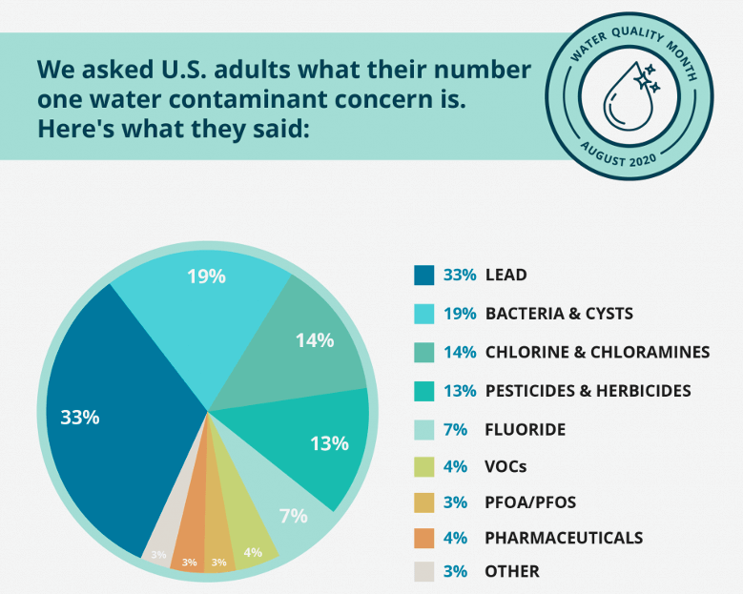
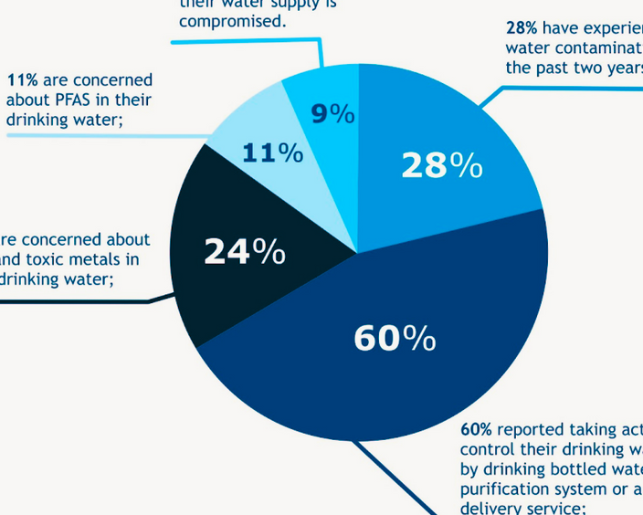
survey

Slide 6
Existing Solutions
■Portable Water Quality Test Kits
■IoT-based Water Quality Monitoring Systems:
■Laboratory-grade

Slide 7
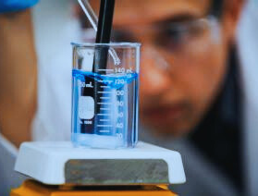
Product Overview
》water quality checkers play a crucial role in ensuring the safety and quality of our water resources.
》A water quality checker is a device designed to analyze the quality of water and provide accurate information about its composition
■Parameters measured:
■Sampling method:
■Portability:
■Maintenance:

Slide 8
SWOT
STRENGTHS:
WEAKNESS:
●The device can be portable, making it easy to use and accessible to local communities
●Using advanced sensors and analytical techniques will improve the accuracy of measurements and promote confidence in the data.
●Developing a cost-effective water quality checker with high accuracy may require significant investment in research and development.
●Users may require training to use the water quality checker and understand the data generated.

Slide 9
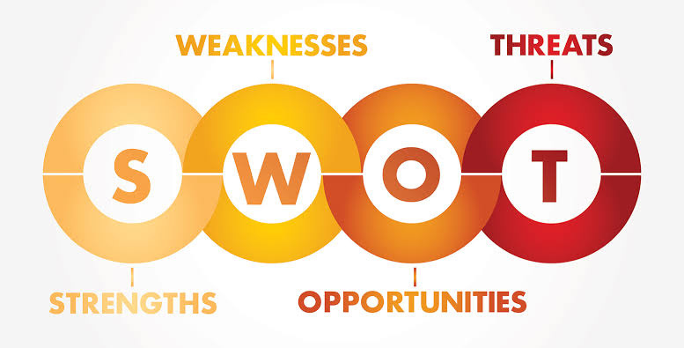
OPPORTUNITIES :
THREATS:
●Competition from other established water quality measurement methods may hinder the adoption of new solutions.
●Changes in regulations or policies may impact the demand and funding for water quality checker devices.
●The lack of awareness and education among local communities may limit the adoption of the technology.
●The increasing demand for clean water globally presents an opportunity to develop innovative solutions that promote sustainable water management practices.
●Partnerships between government agencies, NGOs, and local communities can promote collaboration and drive adoption of water quality checker devices.

Slide 10
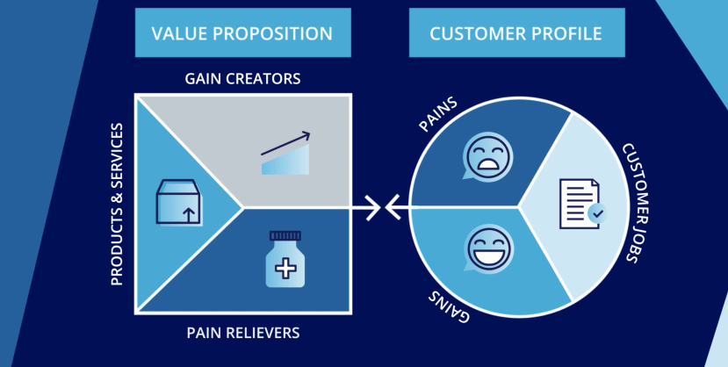
Value proposition (product)
□
Product:
Handheld water quality checker that measures pH, conductivity, dissolved oxygen, and temperature.Waterproof and durable design for use in outdoor and field environments.
Services:
Expert support and consultation for installation, calibration, and troubleshooting.
Regular maintenance and calibration checks to ensure accuracy and reliability of the device.
------
Gain Creators:
Quick and accurate water quality measurements help users to make informed decisions about water use, treatment
Pain Relievers:
◇Eliminates the need for expensive laboratory testing and wait times for results.
◇Helps to prevent health and environmental risks associated with poor water quality.
-----

Slide 11
Value proposition (customer)
○
♧Risk of health and environmental impacts associated with poor water quality.
♧Time-consuming and expensive laboratory testing process.
GAINS:
PAINS:
♧Reduced risk of health and environmental impacts associated with poor water quality.
♧Increased efficiency and cost savings by avoiding expensive laboratory testing and wait times for results.
Customer jobs:
Overall, the value proposition for a water quality checker for the customer is that it helps them to meet their customer jobs of monitoring and maintaining water quality, making informed decisions based on data, and streamlining the testing process

Slide 12
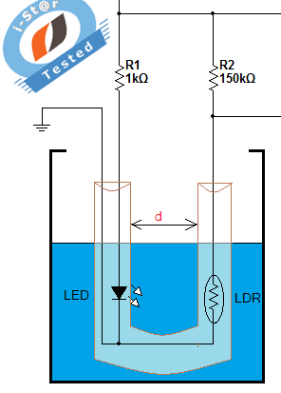
Design Blueprint
How to design a water quality testing programme in four steps
Step one: Define the programme objectives and the partners’ expectations
Step two: Select the water quality testing parameters
Step three: Set up your sampling design, sampling frame and sampling plan

Slide 13



